Slide 1
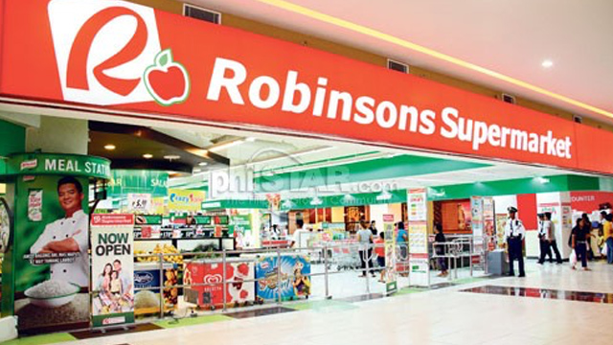
Domain Modelling Example 2: Supermarket Prize Scheme
A supermarket needs to develop software to encourage regular customers.
A customer needs to supply:
  Residence address, telephone number, and driving licence number to register.
Each customer who registers:
  Assigned a unique customer number (CN) by the computer.

Slide 2

Example 2: Supermarket Prize Scheme
A customer can present his CN to the staff when he makes any purchase.
The value of his purchase is credited against his customer’s CN.
At the end of each year:
  The supermarket awards surprise gifts to ten customers who make highest purchase.

Slide 3
Example 2: Use Case Model
Supermarket
Prize scheme
register
customer
Customer
Clerk
register
sales
Sales Clerk
select
winners
Manager

Slide 4
Example 2: Initial Domain Model
SalesHistory
CustomerRegister
1
1
*
*
SalesRecords
CustomerRecord

Slide 5
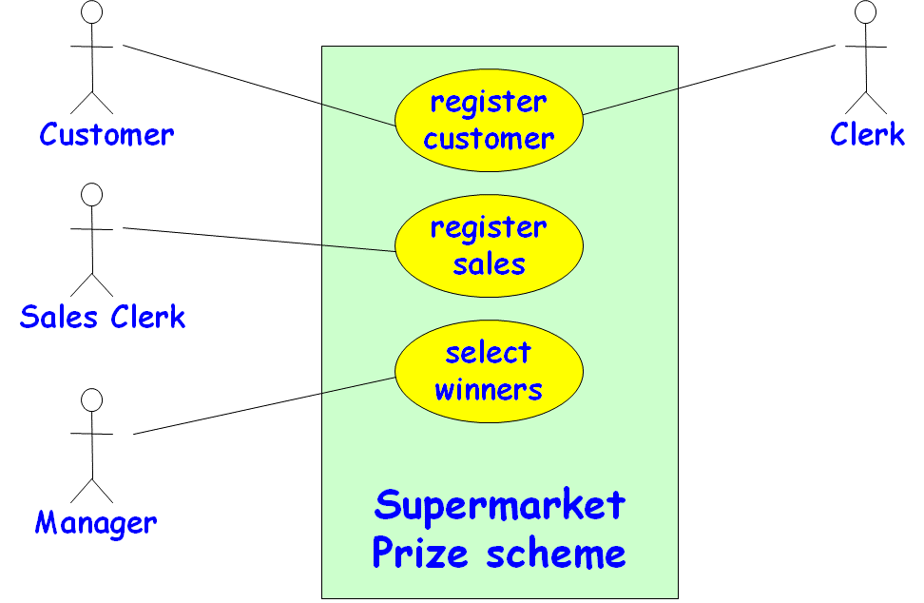
Example 2: Refined Domain Model
SalesHistory
CustomerRegister
1
1
*
*
SalesRecords
CustomerRecord
RegisterCustomerBoundary
RegisterCustomerController
RegisterSalesBoundary
RegisterSalesController
SelectWinnersBoundary
SelectWinnersControllers

Slide 6
Example 2: Sequence Diagram for the Register Customer Use Case
:RegisterCustomer
Boundary
:RegisterCustomer
Controller
:Customer
Register
:Customer
Record
register
register
checkDuplicate
*match
[duplicate]
[duplicate]
showError
showError
generateCIN
create
:Customer
Record
register
displayCIN
Sequence Diagram for the register customer use case

Slide 7
Example 2: Sequence Diagram for the Register Sales Use Case
:Register
Sales
Boundary
:Register
Sales
Controller
:Sales
History
RegisterSales
registerSales
registerSales
:Sales
Record
create
confirm
confirm
Sequence Diagram for the register sales use case

Slide 8
Example 2: Sequence Diagram for the Select Winners Use Case
:SelectWinner
Boundary
:SelectWinner
Controller
:Sales
History
:Sales
Record
:Customer
Register
:Customer
Record
Select
Winners
SelectWinners
SelectWinners
*computeSales
*check
*[for each winner]
announces
find WinnerDetails
*[for each winner]
browse
Sequence Diagram for the select winners use case

Slide 9
Example 2: Class Diagram
SalesHistory
CustomerRegister
selectWinners
registerSales
findWinnerDetails
register
1
1
*
*
SalesRecords
CustomerRecord
salesDetails
name
address
computerSales
check
create
browse
checkDuplicate
create

Slide 10
Exercise 0: Construct Domain Model
The fleet of vehicles at a travel agency consists of vehicles of the types Tata Indica, Maruti van, and Mahindra Xylo.
Customers first register by providing their details and depositing Rs.5000/- with the agency.
The details of the customers such as the name, address, and phone number are maintained by the agency in a customer register.
The registered customers are allowed to rent any vehicle. The details of the travel, date, distance, AC/NonAC are entered by the driver.

Slide 11
Solution
Vehicle
Register
*
Vehicle
*
Indica
Van
Xylo
Rental
*
Customer
Register
*
Customer

Slide 12
Equivalent Solution
Vehicle
Register
*
Vehicle
*
Indica
Van
Xylo
Rental
Customer
Register
*
*
Customer

Slide 13
Exercise 2
Spencer’s retail has set up stores in various cities and some cities have upto 10 stores.
Customers register in a store during their first visit. Each store maintains the set of registered customers.
A registered customers may buy merchandise from any of the other stores.
Dates of their various store visits and purchases need to be kept track of.
Each customer accrues bonus points based on his purchases.

Slide 14
Solution
City
0..10
Spencer
*
Store
*
Purchase
*
visits
Customer
*

Slide 15
Exercise 3
Each institute has many students and many Departments.
A Department offers many courses, but some courses may be offered jointly by two departments.
Each Department has many instructors. Each instructor can be given joint appointment in upto two Departments. Some instructors are professors, while others are associate and assistant professors. One of the instructors of a Department also serves as the Head of the department.
Courses are taught by instructors, who may teach up to three courses. A course can be taught by upto 2 teacher
A student needs to complete 30 courses, but can take only upto 7 courses every semester. The names of the credited courses and the grades obtained in them by a student must be kept track of.

Slide 16
Solution
0..1
HoD of
Institute
assigned to
*
Department
1..2
*
1..2
Instructor
offers
1..2
teaches
Registration
*
*
0..3
Student
Assoc
Prof
Asst
Prof
Professor
30
Course
*
credits

Slide 17
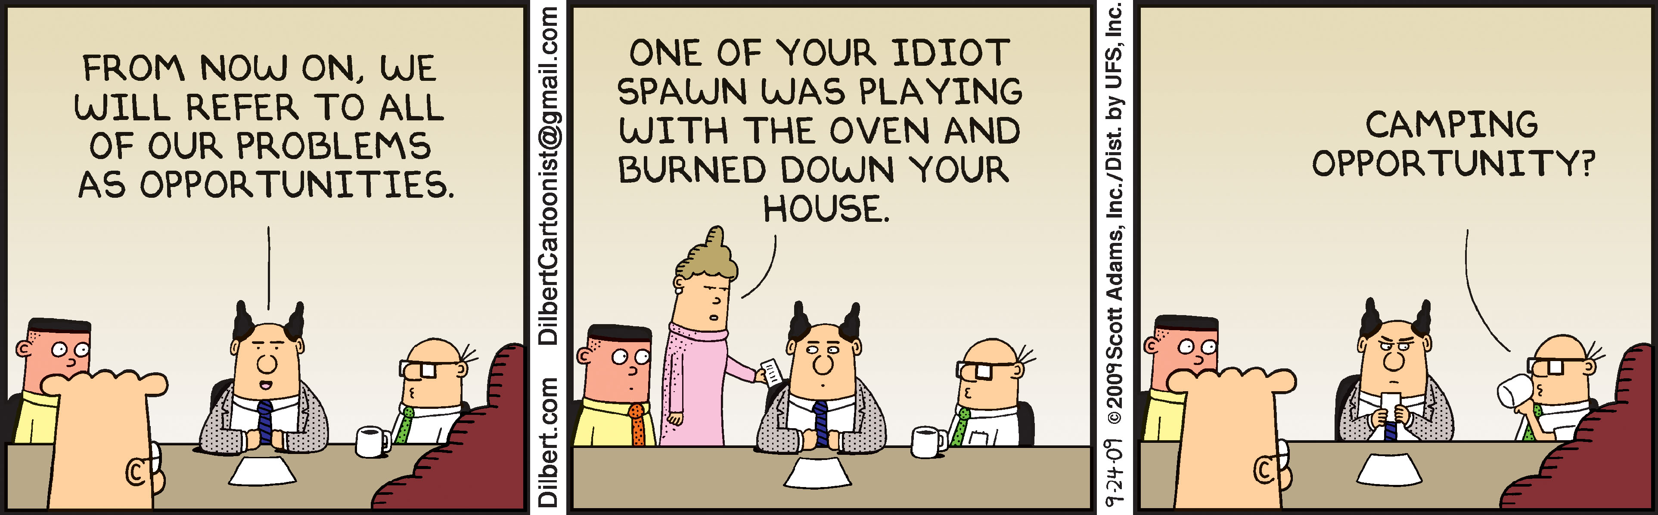

Slide 18
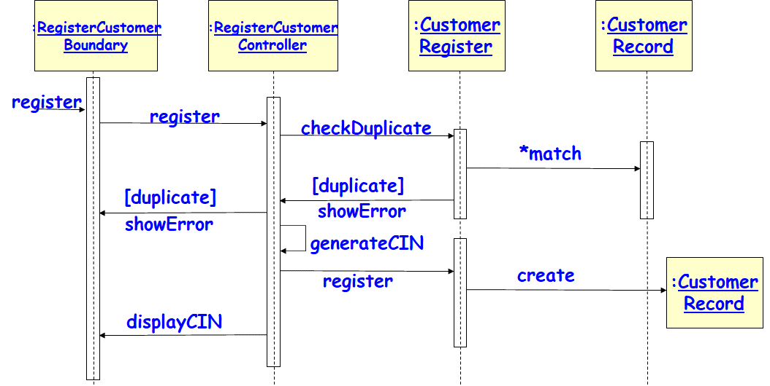
CRC Cards
Used for systematically assigning responsibilities (methods) to classes.
Complex use cases:
  Realized through collaborative actions of dozens of classes.
  Without CRC cards, for complex use cases it becomes difficult to determine which class should have what responsibility…

Slide 19
Class-Responsibility-Collaborator(CRC) Cards
Pioneered by Ward Cunningham and Kent Beck.
Index cards prepared one per each class.
Contains columns for:
  Class responsibility
  Collaborating objects
BookRegister
FindBook
Book
CreateBook
Book
Reserve
Book

Slide 20

CRC Cards: Working
Systematize development of the interaction diagram for complex use cases.
Team members participate to determine:
  The responsibility of classes involved in a use case realization…

Slide 21
CRC Card Cont…
Responsibility:
  Method to be supported by the class…
Collaborator:
  Class whose service (method) would have to be invoked…
BookRegister
FindBook
Book
CreateBook
Book
Reserve
Book

Slide 22
An Example of A CRC Card
Class name
BookRegister
FindBook
Book
CreateBook
Book
Reserve
Book
Responsibility
Collaborator
CRC card for the BookRegister class

Slide 23
Using CRC Cards
After developing a set of CRC cards:
  Execute scenarios: also known as structured walkthrough of scenarios …
Execute a scenario:
  Identify the responsibility to be performed by a class
  It may then pass control to a collaborator ‑‑ another class
  You may discover missing responsibilities and classes

Slide 24
1. Video Rental Store Software
A video rental store has a large collection of video CDs and music CDs as loanable items.
A person can become member a member by depositing Rs. 1000 and filling up details such as name, address, and telephone number. A member can cancel his membership and take back his deposit, if he has no dues outstanding against him.
Whenever the store purchases a new item, details such as price and date of procurement are entered. The daily rental charge is also entered by the manager. After passage of a year, the daily rental charge is automatically halved.
A member can, at a time, take on loan at most three loanable items. The details are entered by a store clerk and a receipt indicating the daily rental charge should be printed by the software.
Whenever a member returns his loaned item(s), the due amount to be paid is displayed. After the amount is paid, the items are marked returned.
If a customer loses or damages any item, the full price of the item is charged to him and the item is removed from the inventory.
If an item is not lent out by anyone for even once over a year, the item is sold at 10% of the purchase price and is removed from the inventory.
The manager can, at any time, check the profit/loss account.

Slide 25
2. Personal Library System
A person can have a few hundreds of books. The details of all the books such as name of the book, year of publication, date of purchase, price, and publisher must be entered. A book is to be given a unique serial number by the computer which would be written by the owner using a pen on the book. Before a friend can be lent a book, he must be registered. The registration data would include name of the friend, address, land line number, and mobile number. Before a friend is issued a book, the various books outstanding against him also with the date borrowed are displayed. The date of issue and the title of the book are stored. When a friend returns a book, the date of return is stored and the book is removed from his borrowing list. Up on query, the software should display the name, address, and telephone numbers of each friend against whom books are outstanding along with the titles of the outstanding books and the date on which those were issued. . The owner should be able to query about the availability of a particular book, the total number of books in the personal library,
The owner of the library software, when he borrows books from his friends, would enter the details regarding the title of books borrowed, and the date borrowed. Similarly, the return details of books would be entered. The software should be able display all the books borrowed from various friends. The owner should be able to query about the availability of a particular book, the total number of books in the personal library,

Slide 26
3. IIT Security Software
The staff and students of IIT register their vehicle by filling up a form which a security staff would enter into the system.
Each time a vehicle enters or leaves the campus, a camera reads the registration number of the car, and the model of the car. If the car is registered, the check gate should lift automatically to let in (or out) the vehicle. The details regarding the entry and exit of the vehicle are registered in the database. For outside vehicles, the driver needs to enter the purpose of entry, the model number, the registration number, and a photograph of the vehicle is stored in the database.
When an outside vehicle leaves the campus, the details are automatically registered in the database. For any external vehicle that is inside the campus for more than 8 hours, the driver is stopped by the security personnel manning the gate, queried to satisfaction, and the response are recorded. Considering that there have been several incidence of speeding and rough driving, the security personnel are empowered to telephone the registration number of errant vehicles to the main gate. For outside vehicles, the driver is quizzed at the check gate and his future entry is barred if the response is not satisfactory. For inside vehicles, a letter is issued to the dean to deal with the employee or student as the case might be.
The security officer can check the data regarding the number of vehicles going in and coming out of the campus (over a day, month or year), the total number of vehicles currently inside the campus.

Slide 27
4. Students’ Auditorium Management Software
Various types of social and cultural events are conducted in the student auditorium. There are two categories of seats: balcony and ordinary seats. The maximum number of balcony seats that can be booked per ticket is 2.
The show manager fixes the prices of the two categories of seats for a specific show, depending on the popularity of a show.
The show manager also enters the show dates, the number of shows on any particular date and the show timings. It is expected that the software would support a functionality to let the show manager configure the different show parameters.
The system should let the spectators query the availability of different classes of seats for a show on-line. A spectator can book a seat for a single show only through regular cash payment and the software should print out the ticket showing the seat numbers allocated. A spectator should be able to cancel his booking before 3 clear days of the show.

Slide 28
5. Travel Agency Automation Software
The company owns a number of vehicles (cars and SUVs) of various make and intends to deploy a web-based software. A customer can become regular customer by depositing Rs. 5,000/- and supplying his name address, and mobile phone number.
When a customer requests for a car, he is displayed the types of vehicles are available, and their charges. For every vehicle, there is a per hour charge, and a per kilometer charge. A vehicle can be rented for a minimum of 4 hours. An AC vehicle of a particular category is charged 50% more than a non-AC vehicle of the same category. There is a charge of Rs 300 for every night of halt regardless of the type of the vehicle.
A customer can book a vehicle, only if he has at least Rs. 2000/- advance. The customer needs to enter when he expects to return the car. When the car is returned, depending on the usage, if possible the amount is fully adjusted from the advance, or he has to pay additional amount to cover the cost incurred.
The company can acquire new vehicles and add them to the fleet of its vehicles. Cars may be condemned and sold off. A car which is currently with the company can be in one of three states: it may have gone for repair, it may be available, it may be rented out. If it is rented out, the company records the date and time when it has been rented out, and the mile-meter reading of the car at that time.
The company also wants to maintain the maintenance and running expense for each vehicle.
The manager of the company should be able to query statistics about various types of vehicles, their prices, average expense on repairs for the car, average demand, revenue earned, and fuel consumption of the car.

Slide 29
6. Newspaper Delivery Automation System
The local newspaper and magazine delivery agency has asked us to develop a software for him to automate various clerical activities associated with his business.
The customers usually subscribe one or more news papers and magazines. Customers should be able to initiate new subscriptions and suspend subscription for a particular item either temporarily or permanently through a web browser•
The customers may ask for stopping the deliveries to them for certain periods when they go out of station.
For each delivery person, the system must print each day the publications to be delivered to each address. The system should also print for the news agent the information regarding who received what and a summary information of the current month.
At the beginning of every month bills are printed by the system to be delivered to the customers. These bills should be computed by the system automatically.
The manager must be able to view the total receipts every month.

Slide 30
7. Restaurant Automation Software
The computer should maintain the prices of all the items:
  Also support changing the prices by the manager.
Whenever any item is sold:
  The sales clerk would enter the item code and the quantity sold.
  The computer should generate bills and register the payments.
Whenever ingredients are issued for preparation of food items, the data is to be entered into the computer.
Purchase orders are generated on a daily basis, for all ingredients whose stock falls below a threshold value.
  The threshold value for each item is computed based on the average consumption for the past three days and assuming that two days stock must be maintained.
Whenever the ordered ingredients arrive, the invoice data regarding the quantity and price is entered.
  If sufficient cash balance is available, the computer should print cheques against invoice.
Monthly sales receipt and expenses data should be generated whenever the manger would request to see them.

Slide 31
8. City Road Maintenance System
A city corporation has branch offices at different suburbs of the city. Residents would raise repair requests for different roads of the city on line.
The supervisor at each branch office should be able to view all new repair requests pertaining to his area.
  The supervisor visits the road and studies the severity of road condition and the raw material requirement for carrying out the repair work, the types and number of machines required, and the number and types of personnel required.
  The supervisor enters this information through a special login in the web site.
Based on this data, the system should schedule the repair of the road depending on the priority of the repair work and subject to the availability of raw material, machines, and personnel.
This schedule report is used by the supervisor to direct different repair work.
The manpower and machine that are available are entered by the city corporation administrator. He can change these data any time.
The progress of the work is entered periodically by the supervisor which can be seen by the citizens in the web site.
The mayor of the city can request for various road repair statistics such as the number and type of repairs carried out over a period of time and the repair work outstanding at any point of time and the utilization statistics of the repair manpower and machine over any given period of time.

Slide 32
9. Bookshop Automation Software
BAS should help the customers query whether a book is in stock. The users can query the availability of a book either by using the book title or by using the name of the author.
If the book is not currently being sold by the book-shop, then the customer is asked to enter full details of the book for procurement of the book in future. The customer can also provide his e-mail address, so that he can be intimated automatically by the software as and when the book copies are received.
If a book is in stock, the exact number of copies available and the rack number in which the book is located should be displayed. If a book is not in stock, the query for the book is used to increment a request field for the book.
BAS should maintain the price of various books.
As soon as a customer selects his books for purchase, the sales clerk would enter the ISBN numbers of the books. BAS should update the stock, and generate the sales receipt for the book.
BAS should allow employees to update the inventory whenever new supply arrives.
Upon request by the owner of the book shop, BAS should generate sales statistics (viz., book name, publisher, ISBN number, number of copies sold, and the sales revenue) for any period.

Slide 33
10: Video Rental Store Automation
The store has a large collection of video CDs and DVDs in VHS and MP4 format as well as music CDs.
A person can become member by depositing Rs. 1000 and filling up name, address, and telephone number. A member can cancel his membership and take back his deposit, if he has no dues outstanding against him.
Whenever the store purchases a new item, the details such as date of procurement and price are entered. The daily rental charge is also entered by the manager. After passage of a year, the daily rental charge is automatically halved.
A member can take on loan at most one video CD and one music CD each time. The details are entered by a store clerk and a receipt indicating the daily rental charge is printed.
Whenever a member returns his loaned item, the amount to be paid is displayed. After the amount is paid, the items are marked returned.
If a customer loses or damages any item, the full price of the item is charged to him and the item is removed from the inventory.
If an item lies unissued for more than a year, it is sold to the members at 10% of the purchase price and the item is removed from the inventory.
The manager can at any time check the profit/loss account.

